Slide 2
Revel
Learning reimagined
Revel Programming is an interactive learning environment that delivers course content in the format students need.
...imagine if every student came to class ready to learn
Notes:
Revel Programming is designed to help increase engagement with the course materials. From the amount of white space on the page, to the way the content is
segmented, to the count and placement of the interactives, everything has been informed by learning science to reduce the students’ cognitive load, increase retention of material presented, and provide lots of opportunities for practice with immediate feedback.
Revel presents a seamless blend of author-created digital text, media, and assessment and students are able to read, practice, and study in one continuous experience — anytime, anywhere, on any device.

Slide 3
Why did we create Revel Programming?
Conceptual Understanding
Preparedness
Practice
Skills
Students come into class under prepared, having not read the book.
Students learn programming by practicing (i.e. homework), but it can be difficult to give meaningful feedback to every student.
Students come into the course with a wide range of programming experience and problem solving skills.
Students are memorizing solution steps, not building conceptual understanding or learning algorithmic thinking skills.

Slide 4
Revel Programming

Slide 5
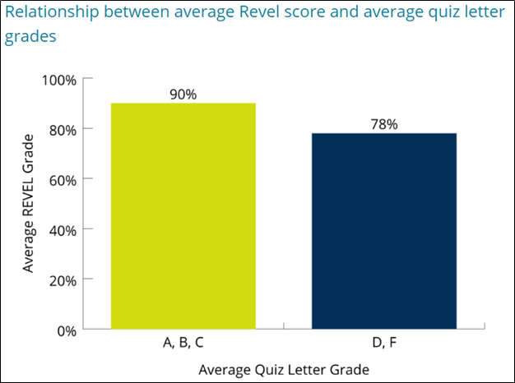
Commitment to Efficacy
Central Michigan University case study
Data for this course indicate that after implementation of Revel average exam scores increased 11 percentage points from the previous semester.
University of Louisiana case study
Students responding to an end-of-semester survey found Revel’s fully integrated read-a-little, do-a-little approach to be an effective way of learning course material.

Slide 7
Clear and Easy-to-Understand Language
Notes:
Teach coding, from the fundamentals to the details
Written with clear, easy-to-understand language, and rich with example programs that are concise, practical, and real-world oriented.
The hundreds of Example Programs are designed to highlight the topic currently being studied. Source code for these programs is provided so that students can run the programs themselves.
Students not only learn how to implement the features and constructs of C++, but why and when to use them.
Teaches C++ in a step-by-step fashion. Each chapter covers a major set of topics and builds knowledge as the student progresses through the book.

Slide 8
Build Knowledge Step by Step
Notes:
Give students opportunities to apply programming concepts and skills
Program Output is a sample of its screen output shown after each example program. This immediately shows the student how the program should function.
In the Spotlight sections provide a programming problem and a detailed, step by step analysis showing the student how to solve it.
A thorough and diverse set of review questions, such as fill-in-the-blank and short answer, check the student’s mastery of the basic material presented in each chapter. These are followed by exercises requiring problem solving and analysis, such as the LiveCode Listings, Predict the Output, and Find the Errors sections.
Concept Statements, Checkpoints, Notes, and Warnings call out important pieces of information for the student.
Case studies that simulate real-world applications appear in many chapters throughout the text. These case studies are designed to highlight the major topics of the chapter in which they appear.
Programming Challenges are designed to solidify the student’s knowledge of the topics currently being studied. Each chapter offers a pool of programming exercises. In most cases the assignments present real-world problems to be solved.
Group Projects are intended to be constructed by a team of students. There are several group programming projects throughout the text and emulate the way many professional programs are written and encourages teamwork within the classroom.

Slide 9
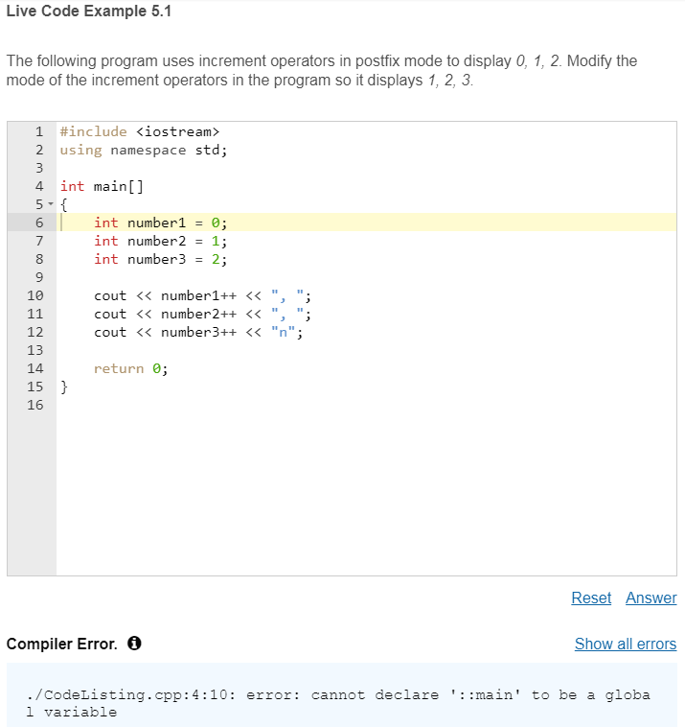
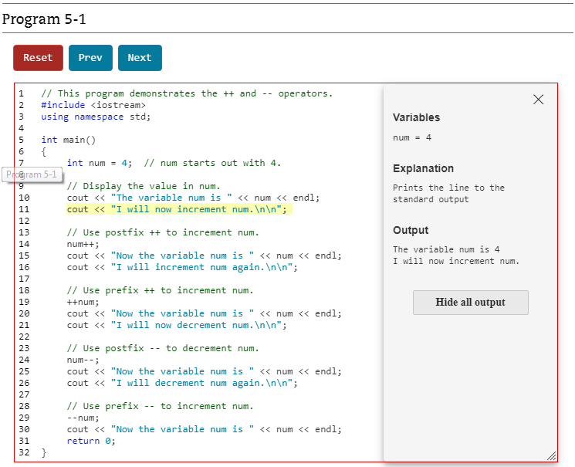
Live Code Examples & Animations Bring Coding to Life
Notes:
Students practice what they've learned, modifying and running live code in the integrated Live Code Examples for retention of key programming concepts.
Animations step students through the code line-by-line with Check Your Understanding points, showing what is happening in the program.

Slide 10
Author Created VideoNotes Bring Coding to Life
Notes:
VideoNotes are narrated step-by-step video tutorials that show how to solve problems completely, from design through coding.

Slide 11
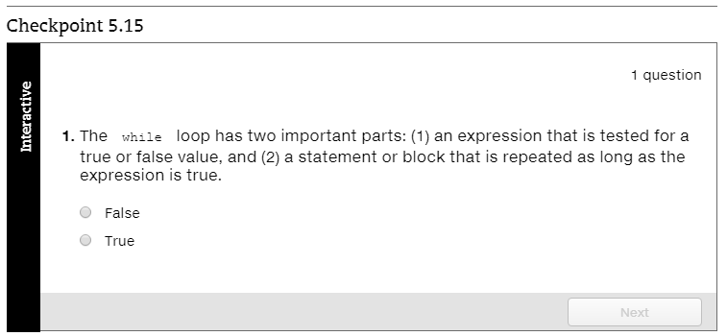
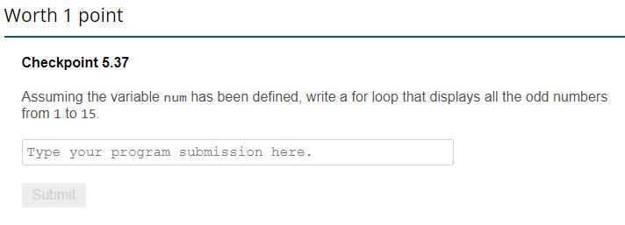
Students Check Their Own Understanding
Notes:
Embedded self-check assessments give students opportunities to check their understanding at regular intervals before moving on. Short code questions DO flow to gradebook.

Slide 12
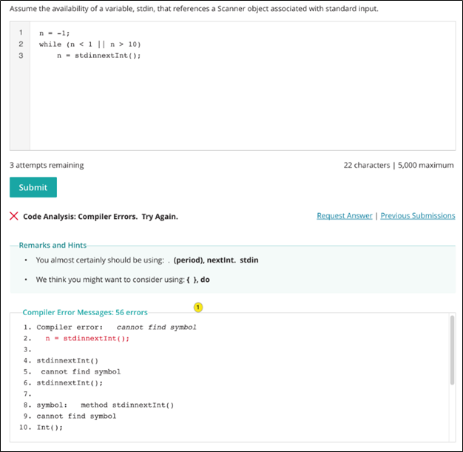
Assign Practice and Assess Coding Skills
Notes:
Assignable/gradable programing exercises, allow students to experience the power of practice as they work through their coding assignments and receive immediate personalized feedback.

Slide 13
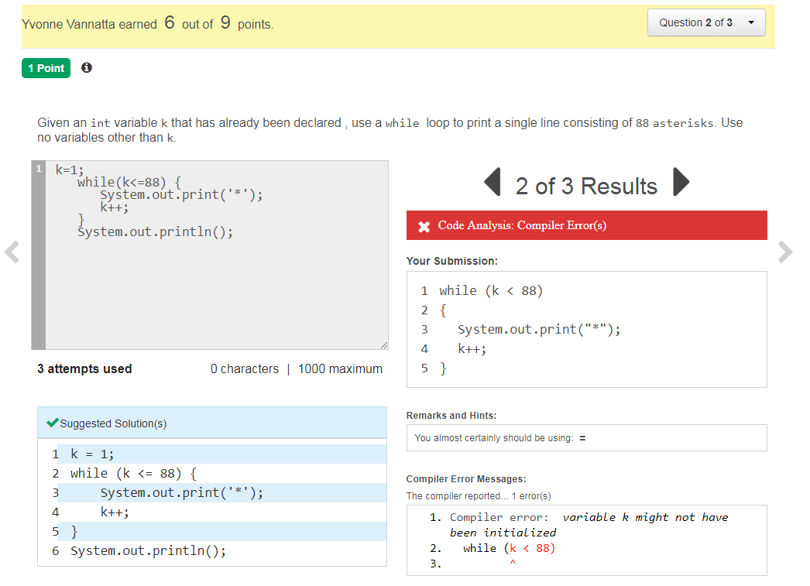
Assess students’ coding skills
Notes:
Programming Exercises also let instructors gauge student comprehension frequently, provide timely feedback, and address learning gaps along the way.

Slide 14
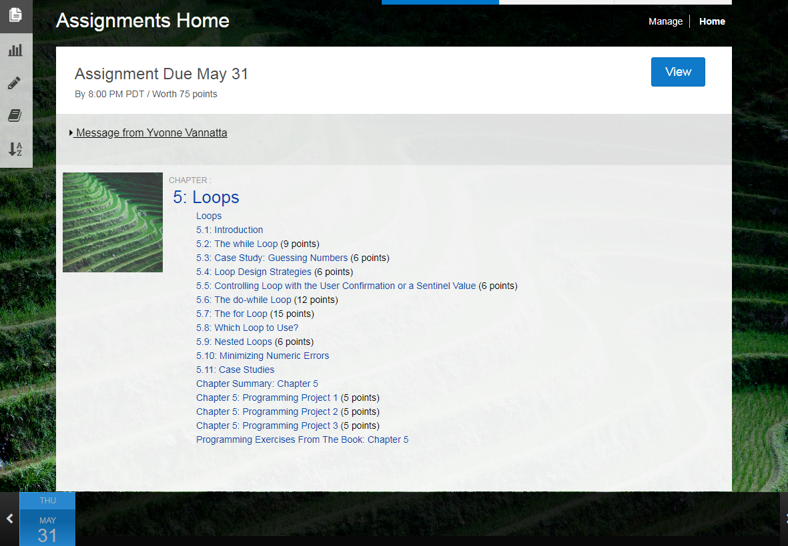
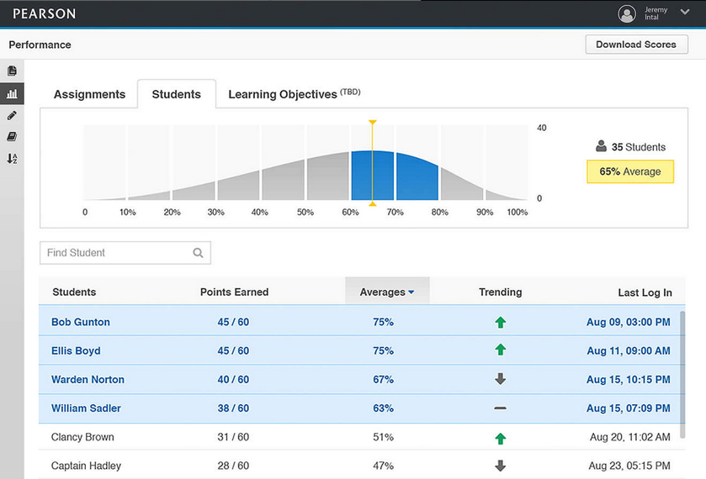
Hold Students Accountable
Notes:
Revel’s assignment calendar allows educators to indicate precisely which readings must be completed on which dates. This clear, detailed schedule helps students stay on task by eliminating any ambiguity as to which material will be covered during each class. When they understand exactly what is expected of them, students are better motivated to keep up.
Revel’s performance dashboard empowers educators to monitor class assignment completion as well as individual student achievement. Actionable information, such as points earned on quizzes and tests and time on task, helps educators intersect with their students in meaningful ways. For example, the trending column reveals whether students' grades are improving or declining, helping educators to identify students who might need help to stay on track.

