Slide 2
Outline
Overall Course Design
Student Background
Teaching Programming Concepts
Python and MindTap

Slide 3
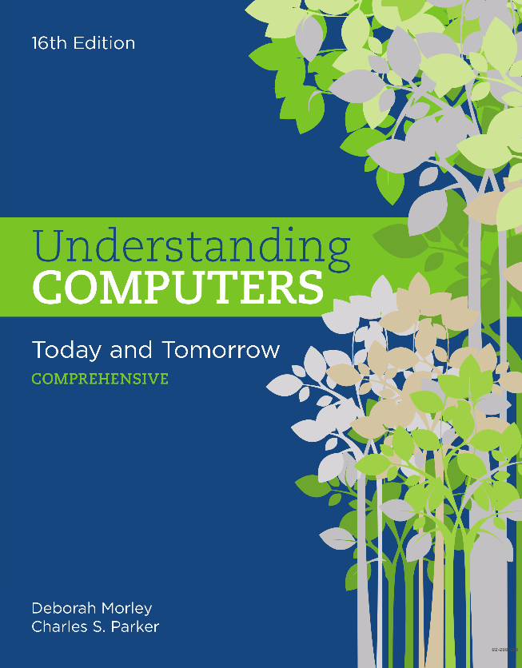
Course Contents and Learning Objectives
CSIT100: Introduction to Computer Concepts
Computer Concepts
Hardware/Software
Network/Internet
Computer Programming
Technology and Society
Computer Skills
Microsoft Excel
Microsoft Access
HTML
Python

Slide 4
Student Background (Fall 2018)

Slide 5
Student Background (Spring 2019)

Slide 6
Student Computer Background
Microsoft Word: ~ 75%
Microsoft PowerPoint: ~ 50%
Image Processing: 5 ~ 10%
Microsoft Excel: 5 ~ 20%
Microsoft Access: 0%
Programming: 0%

Slide 7
Computer Labs: Contents
Excel: Worksheet formatting, formulas and functions, cell reference, charts
Access: Tables, relationships, queries
HTML: Tags (formatting, hyperlink)
Python: Variables, expression and data type, selection control, repetition control

Slide 8
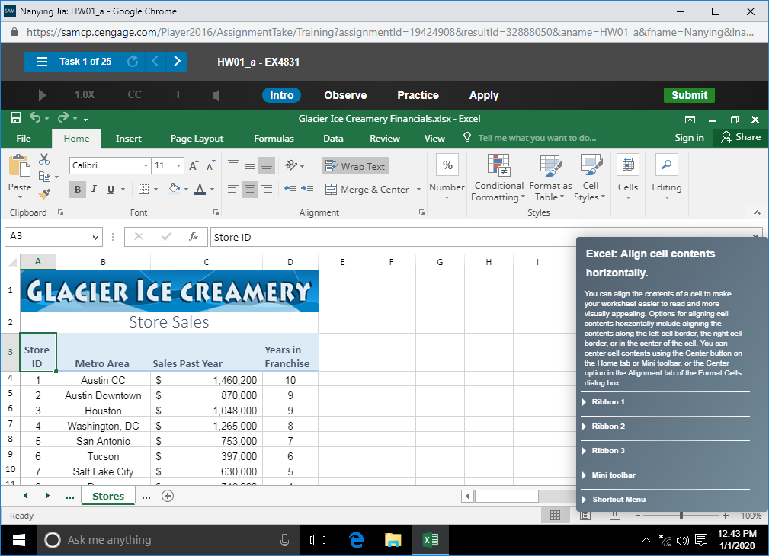
Computer Labs: Approach
Lab activities: Use real applications
Homework: Use MindTap

Slide 9
Build Concepts and Skills around One Major Example
Practice around one major task and a few smaller tasks
Lab 1: spreadsheet basics
Lab 2 & 3: formulas and functions
Lab 4: cell reference
Lab 5: charts

Slide 10
Lab 1: Spreadsheet Basics

Slide 11
Lab 2 & 3: Formulas and Functions

Slide 12
Lab 4: Cell Reference

Slide 13
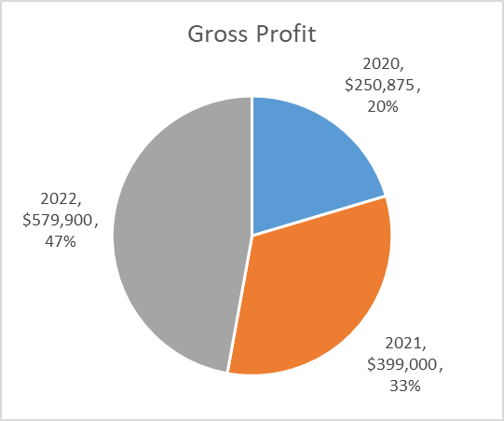
Lab 5: Excel Charts

Slide 14
Lab 5: Excel Charts (cont’d)

Slide 15
Conditional Formatting

Slide 16
Teaching Programming Concepts
Rearrange the lecture sequence to discuss programming one week before Python lab

Slide 17
Prepare Students with Basic Programming Approach (cont’d)

Slide 18
Prepare Students with Basic Programming Approach

Slide 19
Prepare Students with Basic Programming Approach (cont’d)

Slide 20
Prepare Students with Basic Programming Approach (cont’d)

Slide 21
Approach to Learning Python

Slide 22
Python: Contents
Data type
Variables
Statements
Simple Expressions
Control Statements: If-else, While

Slide 23
Python: Lab Design
Lab 1: Variables, data type
Lab 2 & 3: Expressions
Lab 4: Control statements

Slide 24
Example: Python

Slide 25
Example: Python
What’s your name?
Jim
Hi, Jim! Glad to meet you!

Slide 26
Example: Another Python

Slide 27
Example: Another Python
Hi! I'll help you to find out your overall score for CSIT-I00. What's your average score for homework so far?
89.2
What about your midterm exam?
80.4
Ok, your overall score at this moment is
83.92

Slide 28
Python: Approach
IDLE: Use the interactive environments, and create coding page
MindTap: Homework

Slide 29
Lab 1: Introduction
Variables
Expressions
Data type

Slide 30
Data Type: Learn from Mistakes
>>> first=input("What's your first name?")
>>> last=input("What's your last name?")
>>> print("Hi ",first,last,"!")
>>> print("Hi ",first,"!")

Slide 31
IDLE
>>> 2+3
5
>>> a=2
>>> a
2
>>> a=a+1
>>> a
3

Slide 32
Data Type: Learn from Mistakes (cont’d)
>>> width=input("Let's calculate the area of a rectangle. \n What's its width?")
>>> height=input("And what's its height?")
>>> width*height

Slide 33
Data Type: Learn from Mistakes (cont’d)
>>> print("The area of your rectangle is: " width*height)
…
TypeError: can't multiply sequence by non-int of type 'str'
What's wrong??

Slide 34
Lab 2 & 3: Expressions
Build simple expressions
Use one main example for the next 3 labs

Slide 35
Expressions

Slide 36
Expressions (cont’d)
Paystub.py, Version 1
Frequently made mistake: name mismatch

Slide 37
Expressions (cont’d)
Paystub.py, Version 2

Slide 38
Control Statements: if-else
if <condition>:
<sequence of statements-1>
else:
<sequence of statements-2>
condition
Yes
(TRUE)
statements-1
No (FALSE)
statements-2

Slide 39
PayStub: With Control Statements, Comments

Slide 40
Python on MindTap
Good interactive environment for students to practice
MindTap Login
Notes:
https://www.cengage.com/dashboard/#/login
nyjia@yahoo.com / N..1
jian@Montclair.edu / R…1

Slide 41
Issues
Variable = expression (not used to the concept)
Errors caused by typos (Suggested to use Copy/Paste)
Data types

